Slide 1

Eniac
Brazilian market launch analysis
DATA#004 – Data Science Bootcamp 2022
Group 1 Kavitha, Yousra, Anja

Slide 2
# Eniac – Brazilian Market Launch
Eniac is exploring an expansion to the Brazilian market and is seriously considering Magist to be their temporary local collaboration.
Magist is a SaaS company providing an OMS to connect small and medium-sized stores with Brazilian marketplaces.
Main concerns:
Does Magist connect to the right marketplace for Eniacs’ portfolio?
Are Magists’ company values in line with Eniacs’?
Notes:
Magist is a Brazilian Software as a Service company that offers a centralised order management system to connect small and medium-sized stores with the biggest Brazilian marketplaces.

Slide 3
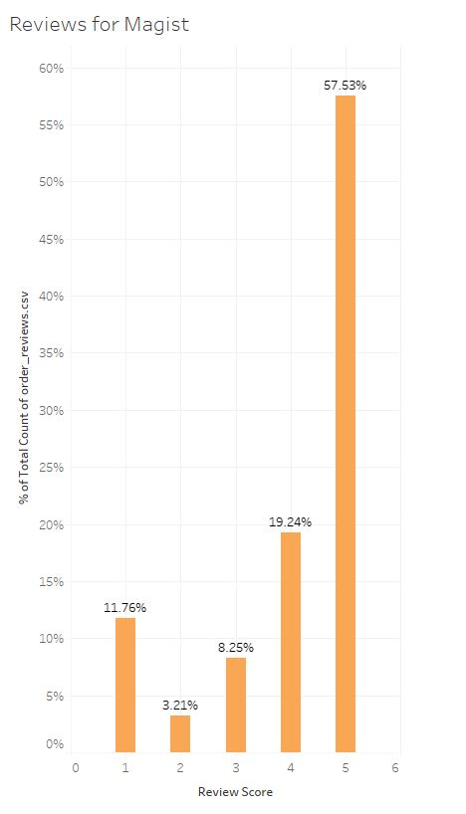
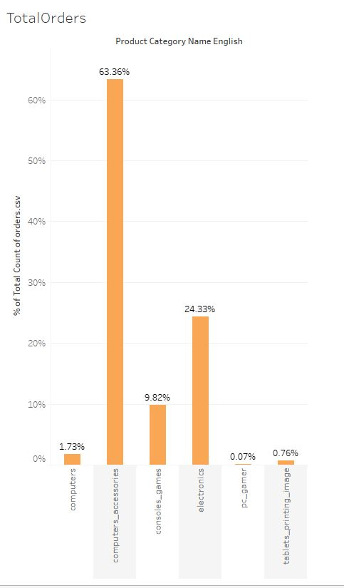
# The Market Place of Magist
Approximately 75% orders via Magist are rated with scores of 4 or higher
63% of sold tech products
are computer accessories
Customer experience rating on orders via Magist
Share of sales of computer accessories In total sale of tech products
Notes:
Magist is a Brazilian Software as a Service company that offers a centralised order management system to connect small and medium-sized stores with the biggest Brazilian marketplaces.

Slide 4
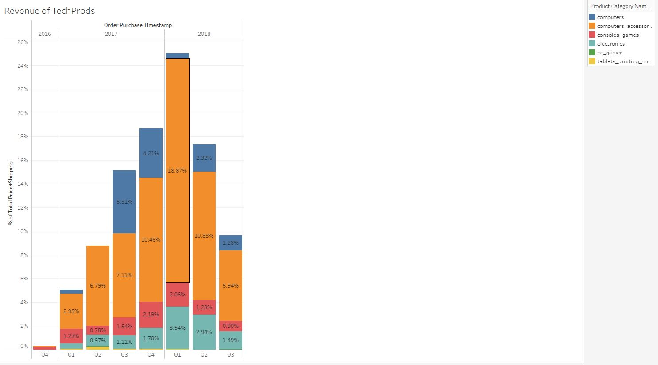
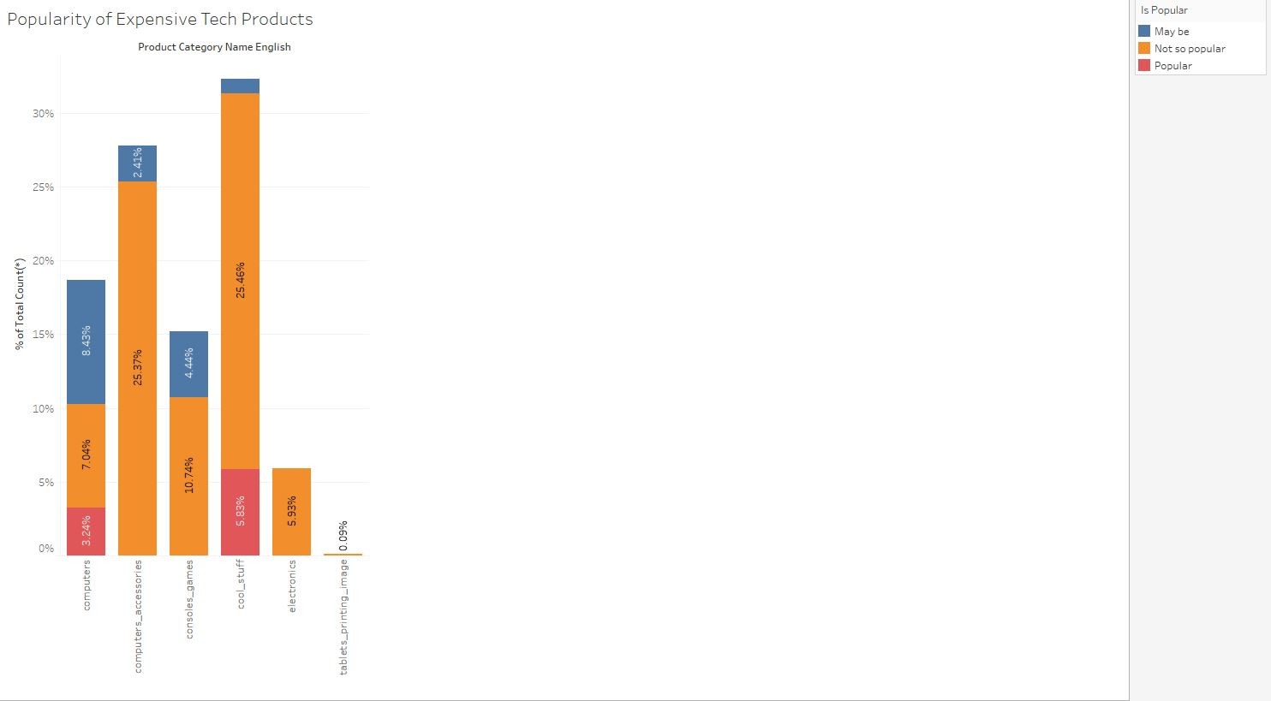
# Market Place for Tech Products
The sale of computer accessories generates
a major share of Magists total earned revenue on tech products
Though Magist does not seem to be a favoured
place to order expensive computer accessories -
rated by the number of orders in the given database snapshot
Share of revenue of computer accessories on total revenue for tech products by quarter
Popularity of orders for expensive tech products (assumptions: price > 300 BRL and > 30 orders in the given time
Notes:
The minimum wage guaranteed by law in Brazil stood at 1,100 Brazilian reals per month in 2021.
The average monthly wage in Brazil is 8,560 BRL (Brazilian Real) per month and 1,02,720 BRL per year.

Slide 5
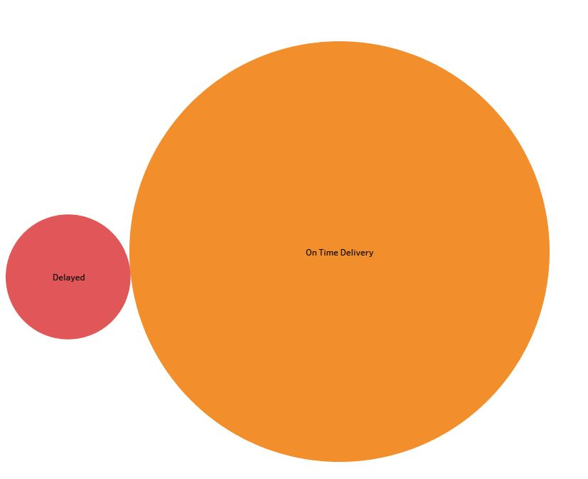
# Delivery of Products
Does Magist meet our company value of customer satisfaction with view to delivery times?
For appr. 9% of all orders, the delivery date exceeds the estimated delivery date
Out of these delayed orders appr. 20% are for big products (>= 20 cm³)
Delivery status of all orders

Slide 6
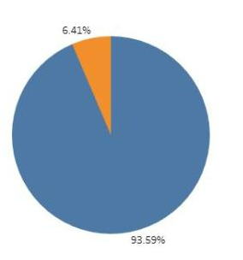
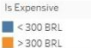
# The Recommendation / Group 1
75% of Magist customers are happy based on the reviews
63% among the total tech products sold are computer accessories
91% of overall deliveries are on time
6,5% of ordered tech products are from the upper price segment
The devaluation of the Brazilian Real makes more expensive, high-end products even less affordable
There is only a small customer base for selling expensive high-end products on Magist platform.
Our recommendation is to first research for other potential provider.
Price comparison among tech products
Notes:
Computer accessories are very popular among tech products on Magist platform.
And even though the COVID pandemic creates a high demand on IT equipment
The minimum wage guaranteed by law in Brazil stood at 1,100 Brazilian reals per month in 2021. The average monthly wage in Brazil is 8,560 BRL (Brazilian Real) per month and 1,02,720 BRL per year.
Unpopular means: less than 30 orders on the product during the given period of time

